Slide 1
Package development and publishing in R
Soroor Hediyeh-zadeh
R-Ladies Urmia
June 2022

Slide 2
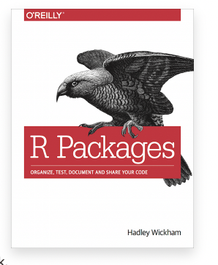
Outlines
Where to publish a R package
Essential libraries for package development : devtools and roxygen2
Create the building blocks using Rstudio
Key development workflows
Description of package architecture
DESCRIPTION
NAMESPACE
R/
man/
data/
inst/
Vignettes/
Access the book here for free https://r-pkgs.org/

Slide 3
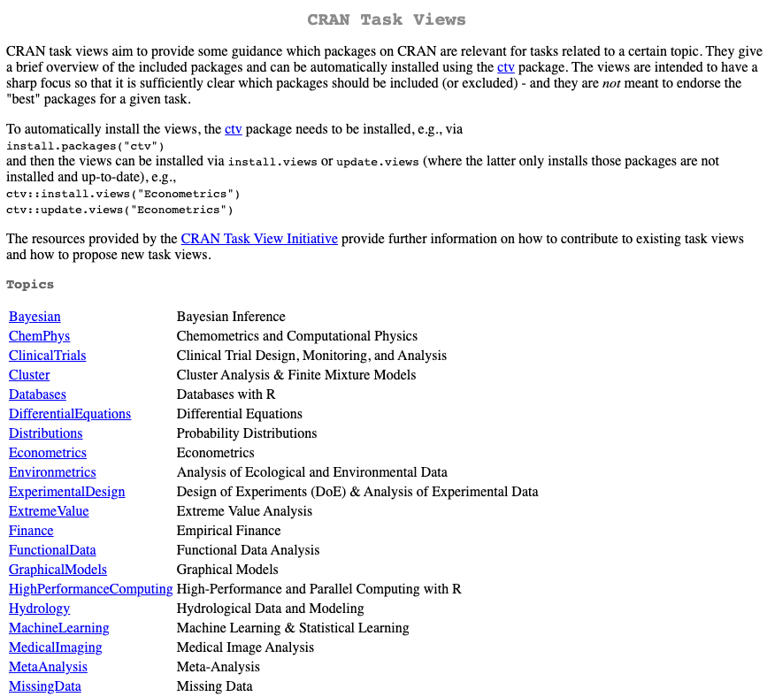


Where to publish a R package
GitHub – for packages/package versions that are still under active development. https://github.com
CRAN – the official repository for R pacakges. https://cran.r-project.org/
Bioconductor – an open-source repository for bioinformatics tools. https://bioconductor.org/

Slide 4
Essential libraries for package development
Devtools – build, test, build checks, develop
Roxygen2 – documentation markup

Slide 5
Now let’s continue in R-studio

Slide 6
Description of package architecture
DESCRIPTION
Package title, package description, version, dependencies, author information, contacts etc
NAMESPACE
Lists all imported and exported functions. Generated automatically by roxygen2. DO NOT modify manually
R/
Where r scripts are kept
man/
Help pages are stored here. The contents are generated automatically by roxygen2
data/
Where data is held
inst/
Where NEWs file or codes from other programming languages are help (e.g. python)
Vignettes/
Vignettes are workflow tutorials- Rmd or Rnw files

Slide 7
Key development workflows
Devtools::load_all()
Use upon every change/modification to functions. Loads new changes
Devtools::document()
Updates documents/writes new documentations to man/
Devtools::check_build()
Checks for coding consistencies, missing documentations or export/imports. Makes sure that a package is functional and self-contained

Slide 8
Summary
Where to publish a R package
Essential libraries for package development : devtools and roxygen2
Create the building blocks using Rstudio
Description of package architecture
DESCRIPTION
NAMESPACE
R/
man/
data/
inst/
Vignettes/
Key development workflows
Package versioning and licensing are important concepts not covered here. See the book for more details.
Check the usethis library. This is the more modern (and convenient) way of building R packages.
The book is your friend!

